Slide 1

DIY Mapping
My story of getting into DIY mapping on OpenStreetMap
@talllguy
Elliott Plack
Notes:
Hi I'm Elliott

Slide 2
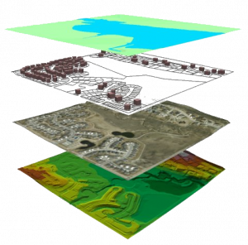
Background
I have always loved maps!
Studied geography at Towson University
Work at Baltimore County GIS
Notes:
Love maps
Studied geography at Towson University
Work at Baltimore County doing GIS

Slide 3

I'm big into foursquare
Was the first Superuser 3
Got involved with a small community of superusers
When foursquare switched to Mapbox superusers complained about the lack of detail
I started mapping to help out
Notes:
Foursquare is a social networking platform that revolves around users checking in at locations
Foursquare promotes involved users to superusers that can help improve the database
I got involved early and became the first superuser 3
Communicate regularly with other SU3s
When foursquare switched to Mapbox for its maps I was excited
Superusers complained about the lack of detail
Let me show you

Slide 4
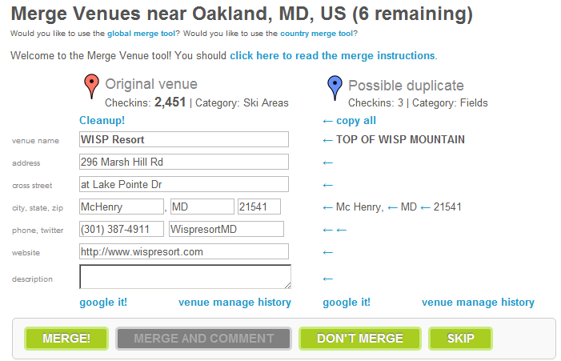
Wisp Merge

Slide 5
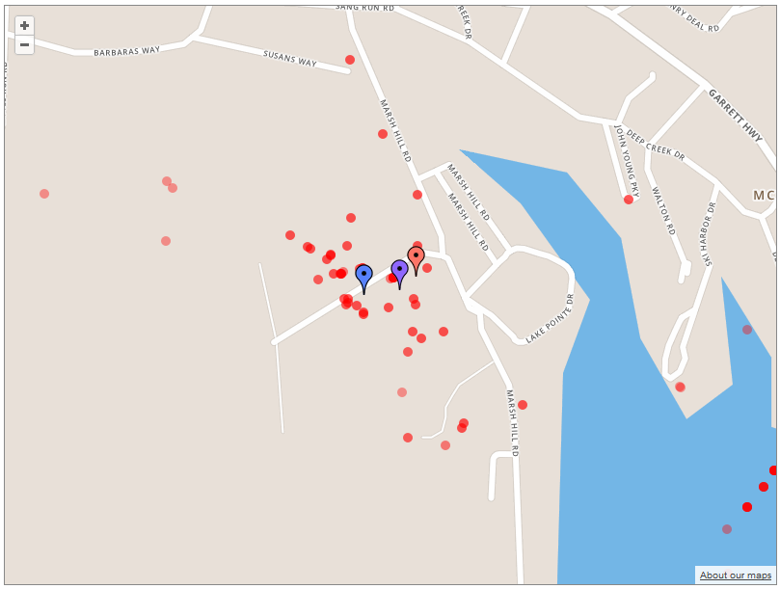
Notes:
Red Dots are checkins
Sparse here. Where is the ski resort?

Slide 6
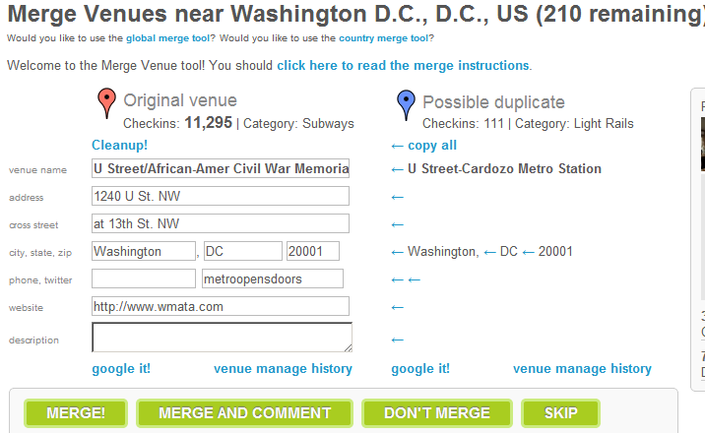
U Street Station Merge

Slide 7
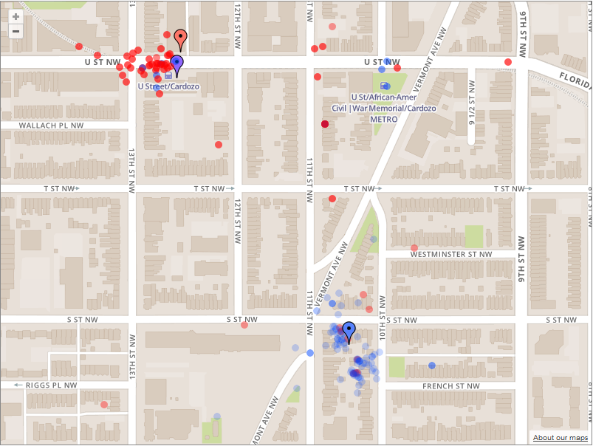
Notes:
Crystal clear in this case where the venue should be due to Mapbox labels.

Slide 8
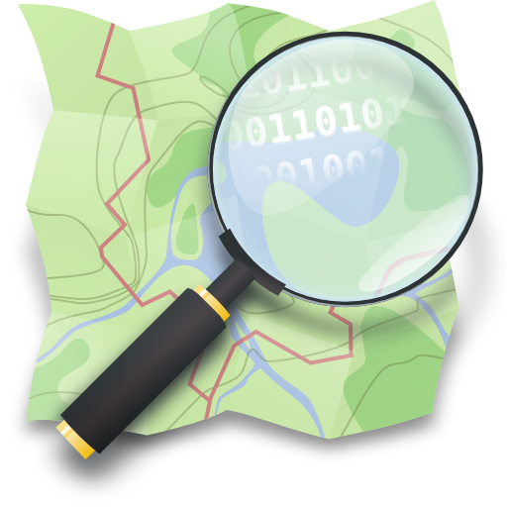

Partnered up
Starting having meetups with a fellow geographer
Tackled mapping out Towson U. campus, where we studied
@
Notes:
In order to get started, I picked an area I knew well
I watched the college I went to go through a major campus redesign
That wasnt on any map
I took action

Slide 9
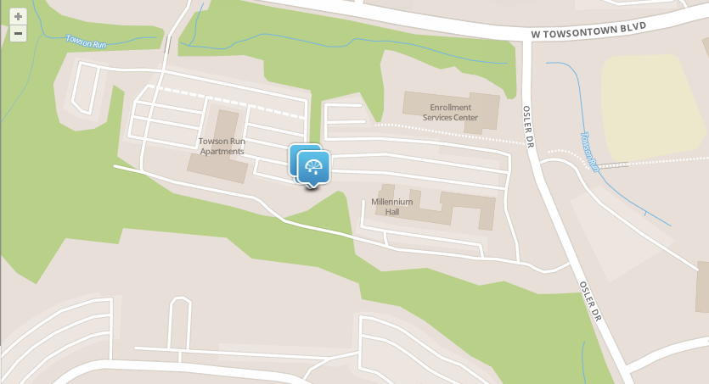
Before
Notes:
Note the lack of detail

Slide 10
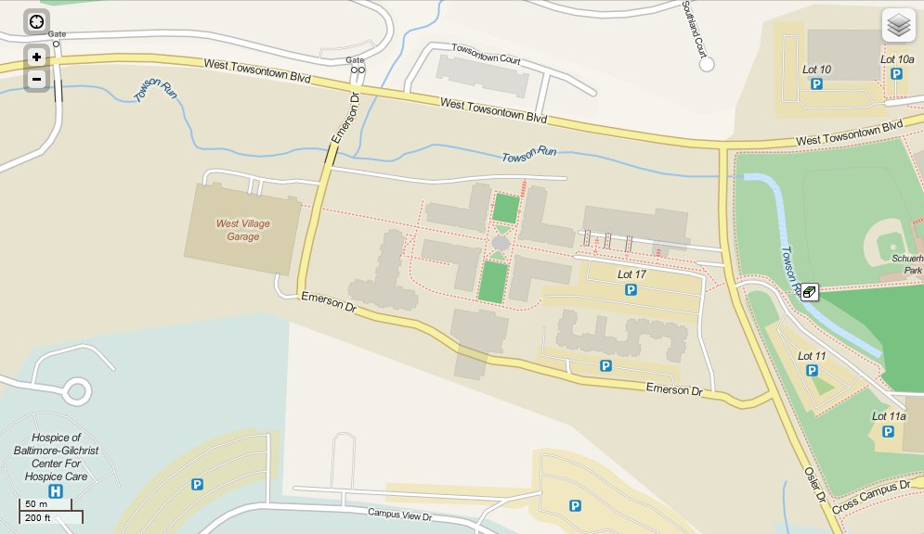
After

Slide 11
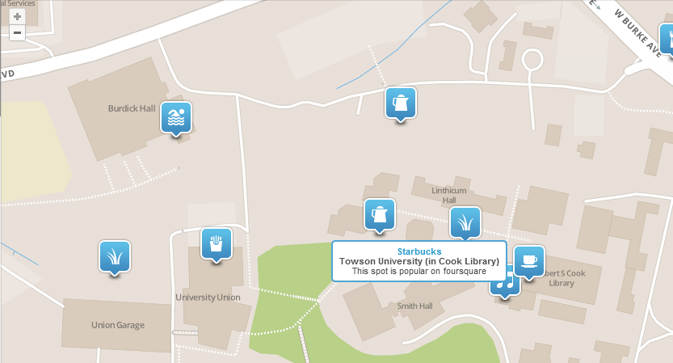
Before

Slide 12
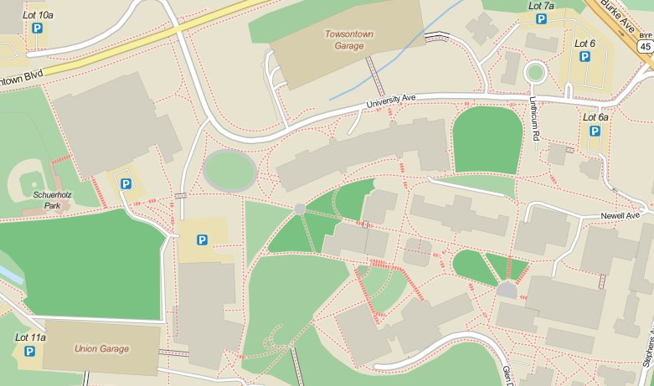
After

Slide 13
Moving Forward
Rarely a day goes by where I'm not mapping
Adding road related changes that I come across at work
Adding neighborhoods from plats
Adding anything else
Baltimore City data import
Notes:
I'm adding to OSM every day
when I go places, I think of how I can help out
Constantly finding roads that are wrong and need adjustment
Neighborhood boundaries from plats
Baltimore city free data
Getting together with friends
Should be exciting

Slide 14

DIY Mapping by Elliott Plack
Follow me
ElliottPlack
@talllguy
talllguy

